Slide 1
Geo-localization using Triangulation
Melissa Osorio,
Vincent Razo,
Nghia Phan,
Steven Rico
Notes:
s

Slide 2
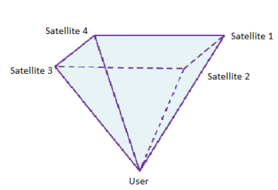
Geo-Localization Model
In this project we consider a user with unknown position, and n=4,5,... satellites with known positions.
In real life GPS localization, the user sends signals to each satellite. Each satellite computes the distance to the user and the distance to each other satellite. Then, the satellites apply numerical methods to triangulate the user’s position.
In this project, we would like to model this situation and analyze the sensitivity and error on this model.

Slide 3
The Model
Let r_{n} = <X_{n},Y_{n},Z_{n}> be the radius from the nth satellite to the user with x,y,z coordinates in space. These are our given parameters. We would like to triangulate x = <x,y,z> where x is the user position in x,y,z coordinates.
There are many numerical methods we could apply, but we would like to study the Least Squares Method [1] for this project.

Slide 4
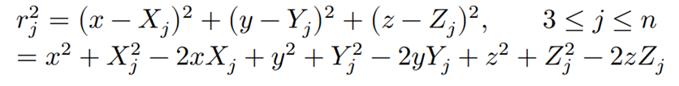
Least Square Method
In Linear Triangulation:
For each receiver r = (x, y, z), the square distance to a set of n fixed-position transmitters at each time step is defined by:
Subtracting LHS by r₁² and RHS by (x-X₁)²+(y-Y₁)²+(z-Z₁)², we obtain

Slide 5
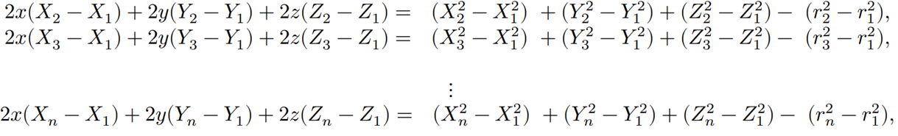
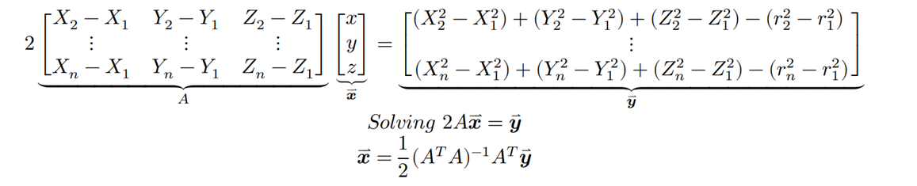
Least Square Method
We have a system of equations,
In matrix form we have,

Slide 6
Least Square Method
The advantages of using the Least Square Method on the system
Ax = b:
It is a non iterative method. Hence, we can apply the method once with no given tolerance or number of iterations.
Iterative methods such as Gauss-Seidel, QR factorization, or Jacobi’s method take many computations in order to solve the system.
We can create a simple function that takes in the satellite positions and the satellite radii in order to apply this method.

Slide 7
Least Square Method
The disadvantages of using Least Square Method:
Depending on many factors, the error between the triangulated position and the actual position can be very large.
That is, with a slight perturbation, the Least Square Method won’t produce the exact user position.
Although, we can determine how sensitive our system is to perturbations, or in our case noise, and how to minimize it.

Slide 8
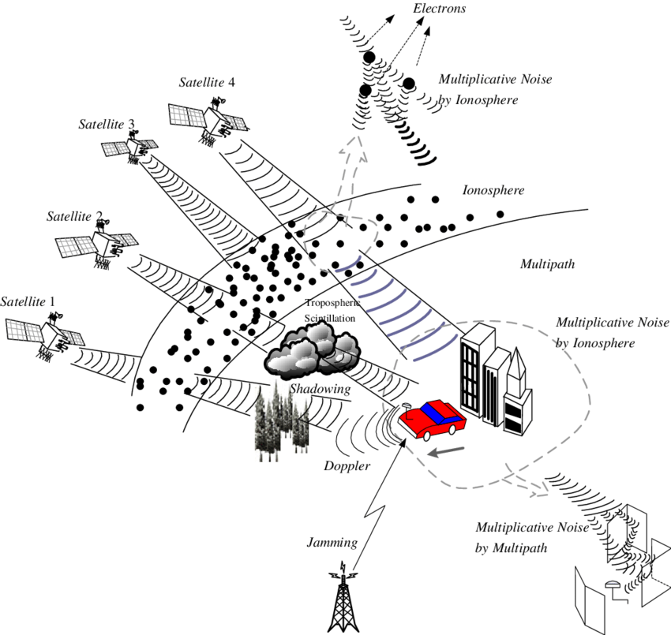
Noise
In our model, we are not precise on where the noise comes from.
When adding noise to our satellites, we added a vector of random elements
ranging from (-2,2) to the b vector.

Slide 9
Satellite Positions
We create a function that generates a desired number of satellites that orbit around the Earth at an altitude of 2000
Initialization
The function prepares to store the positions of the satellites
For each satellite to be generated, the function performs the following steps:
It randomly selects an azimuth angle (angle around the Earth) and an elevation angle (angle above or below the equator)
Using these angles, it calculates the Cartesian coordinates (x,y,z) of the satellite’s position in space relative to the Earth’s center
The function stores these coordinates as the position of the satellite, and then returns a collection of these positions for all the satellites

Slide 10
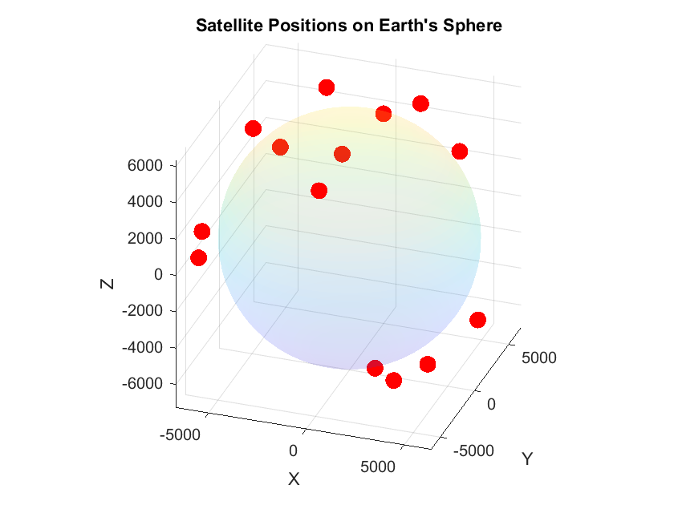
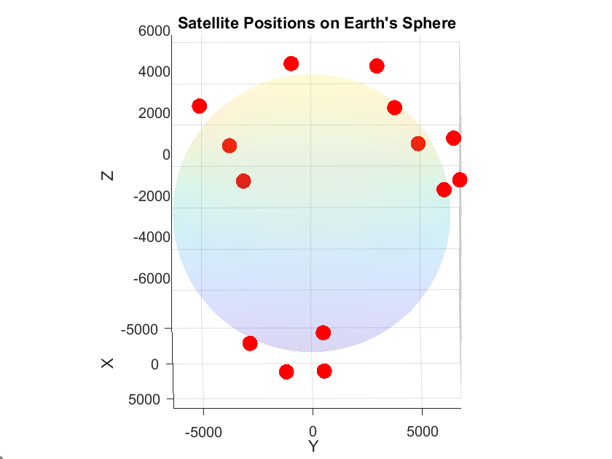
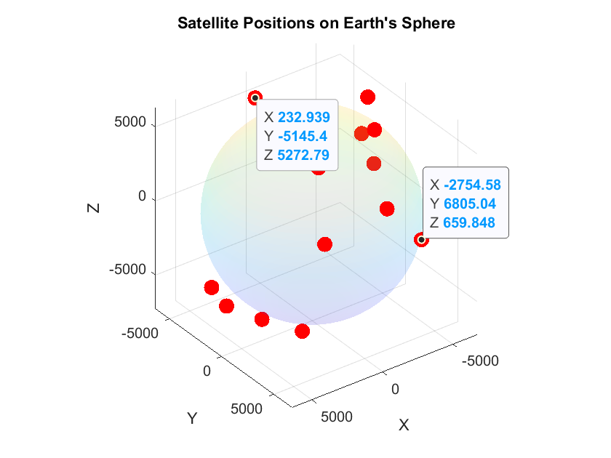
Satellite Positions Images

Slide 11
Satellite Configurations
We create a function that simulates multiple configurations of satellite arrangements around the Earth for a given number of satellite configurations
This is useful because it provides insight into the effectiveness of different satellite setups in terms of precision and accuracy for locating users on Earth

Slide 12
Satellite Configurations
Satellites aligned along the prime meridian
This function generates satellites positions along the prime meridian of the Earth
Initialization
The function initializes a matrix to store the positions of the satellites
Then for each satellite:
It calculates the elevation angle for each satellite based on its position along the prime meridian
Then it uses this angle and sets the azimuth equal to zero to then calculate the Cartesian coordinates (x,y,z) for each satellite
It then stores these coordinates as the positions of the satellites in the matrix

Slide 13
Satellite Configurations
Satellites aligned along the equator
This function generates satellites positions along the equator of the Earth
Initialization
The function initializes a matrix to store the positions of the satellites
Then for each satellite:
It calculates the azimuth angle for each satellite based on its position along the equator
Then it uses this angle and sets the elevation equal to zero to then calculate the Cartesian coordinates (x,y,z) for each satellite
It then stores these coordinates as the positions of the satellites in the matrix

Slide 14
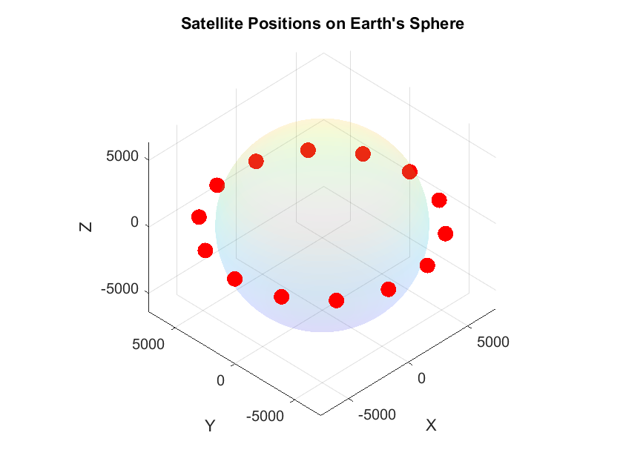
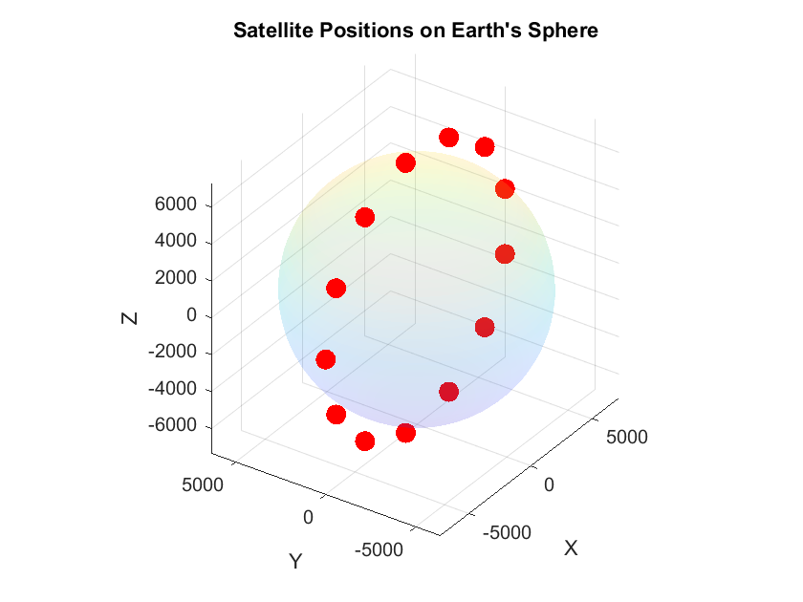
Satellite Configurations

Slide 15
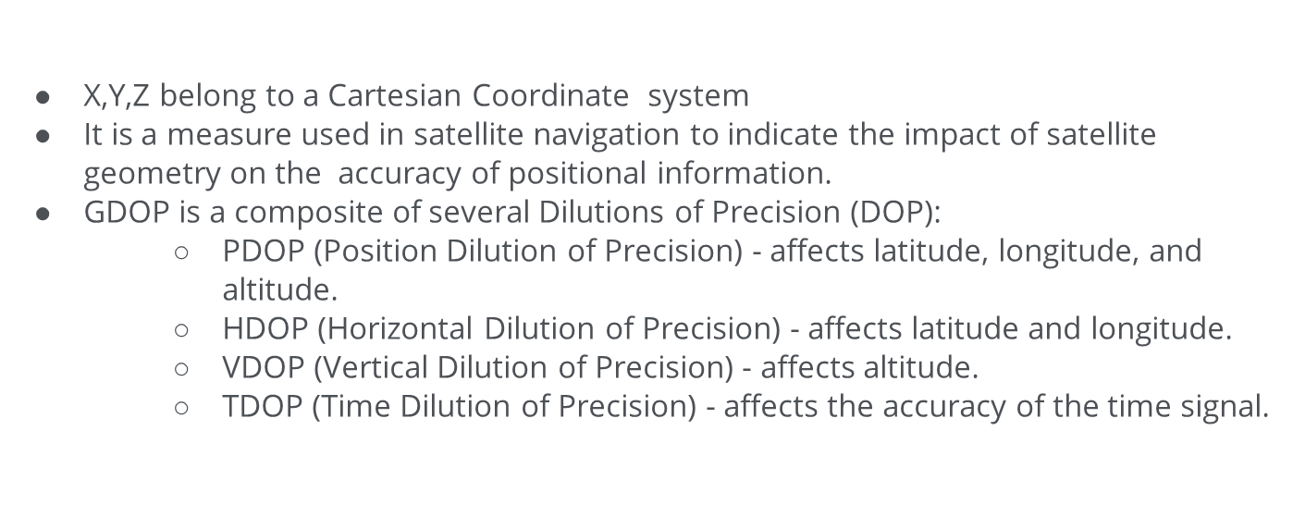
Geometric Dilution of Precision (GDOP)

Slide 16
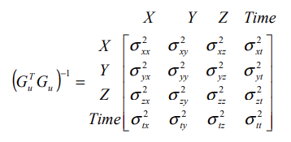





GDOP Matrix
4

Slide 17
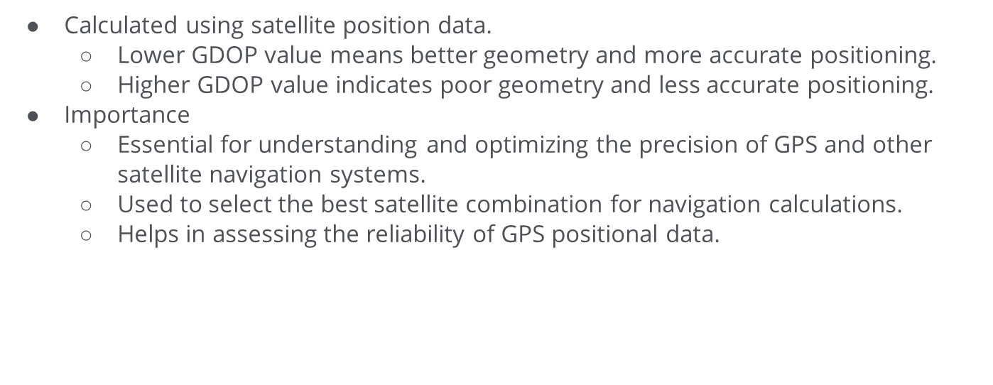
GDOP Calculations
17

Slide 18
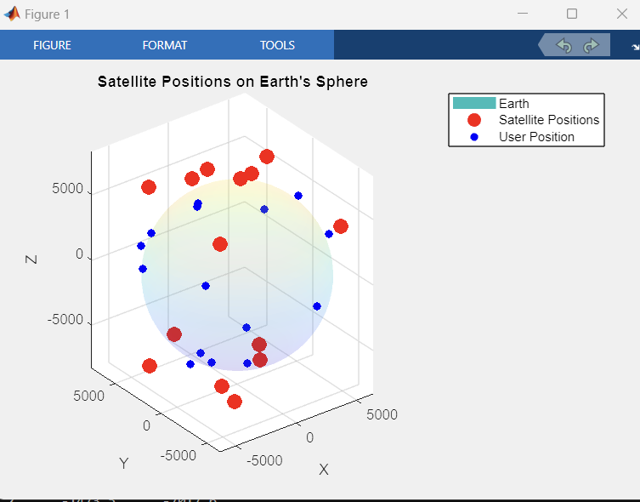
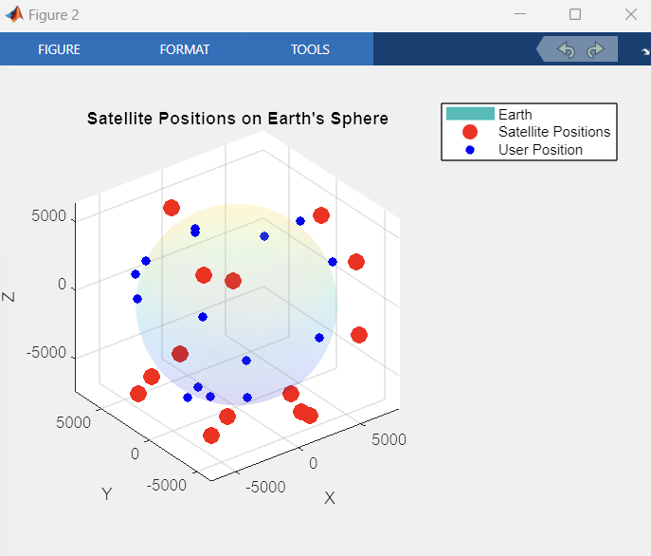
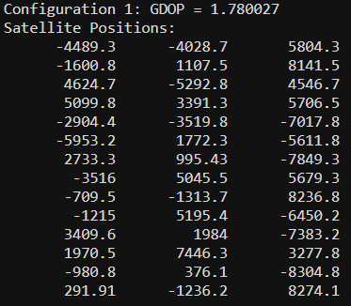
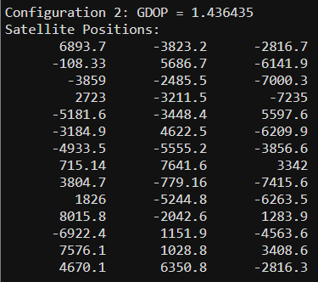
15 Users
14 Satellites

Slide 19
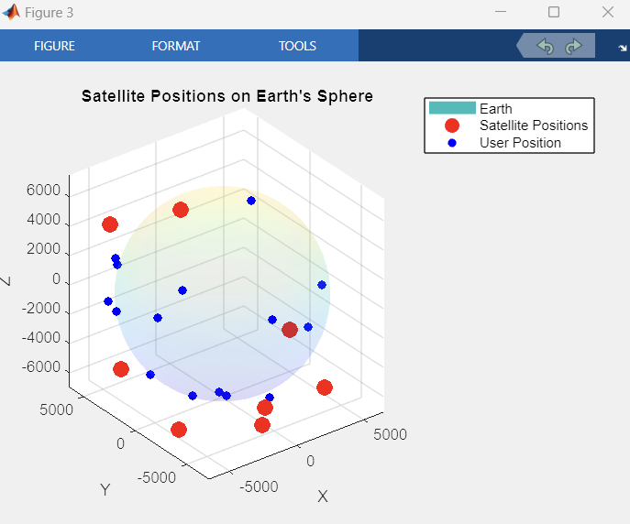
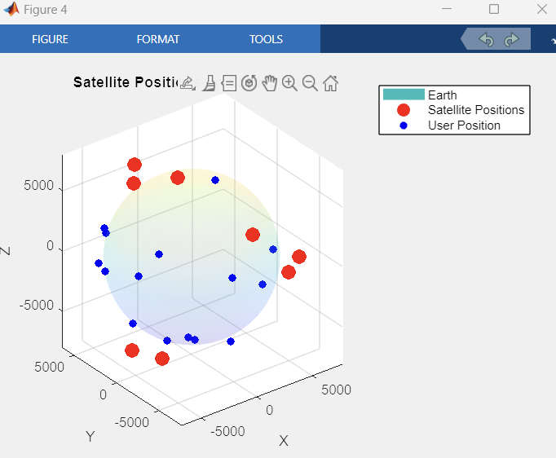
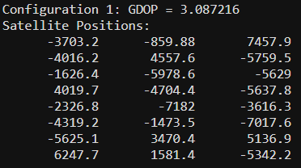
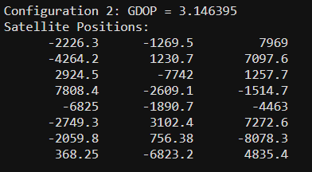
15 Users
8 Satellites

Slide 20
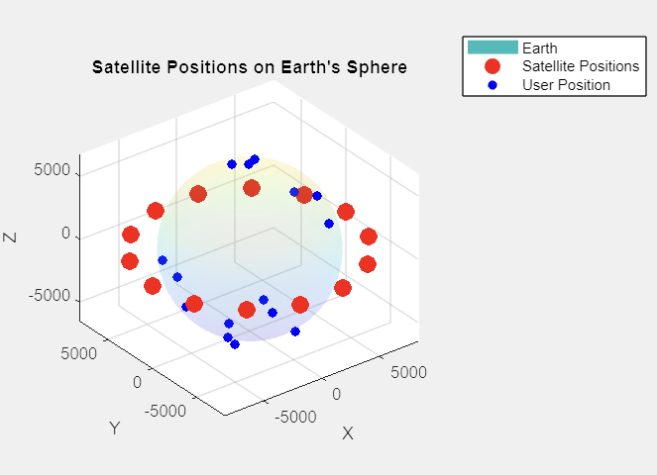
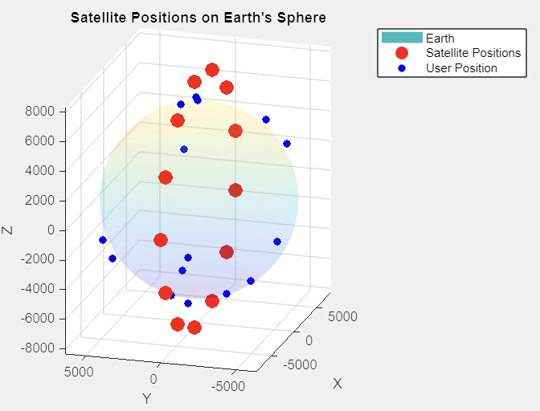
Sensitivity Satellite Configurations
Equator GDOP: 9.395
Prime Meridian GDOP: 9.4846

Slide 21
Error Analysis
The conditioning number of a matrix tells us:
How sensitive the system is to perturbations.
How close the matrix is to being singular
We will analyze the conditioning number and determine what it tells us about our mathematical model.

Slide 22
Condition Number
In the context of the least square method, why would we want to determine the condition number of a matrix? Remember, we are attempting to solve
Therefore, we study the condition number on A^{T}A. The larger the condition number, the closer A^{T}A is to being singular and hence non-invertible.

Slide 23
Condition Number
In linear algebra, the condition number is defined as the sensitivity to error.[2]
In the system Ax=b, we can define the condition number to be
cond(A) = ||A|| ||A⁻¹||. [2]
Here, we use the frobenius, or 2 norm.

Slide 24
Condition Number
Properties of condition number: [2]
From cond(A) = ||A|| ||A⁻¹||,
cond(λA) = cond(A)
cond(A) > 1
Good condition as cond(A) → 1
Bad condition as cond(A) → ∞
If A is singular, cond(A) = ∞

Slide 25

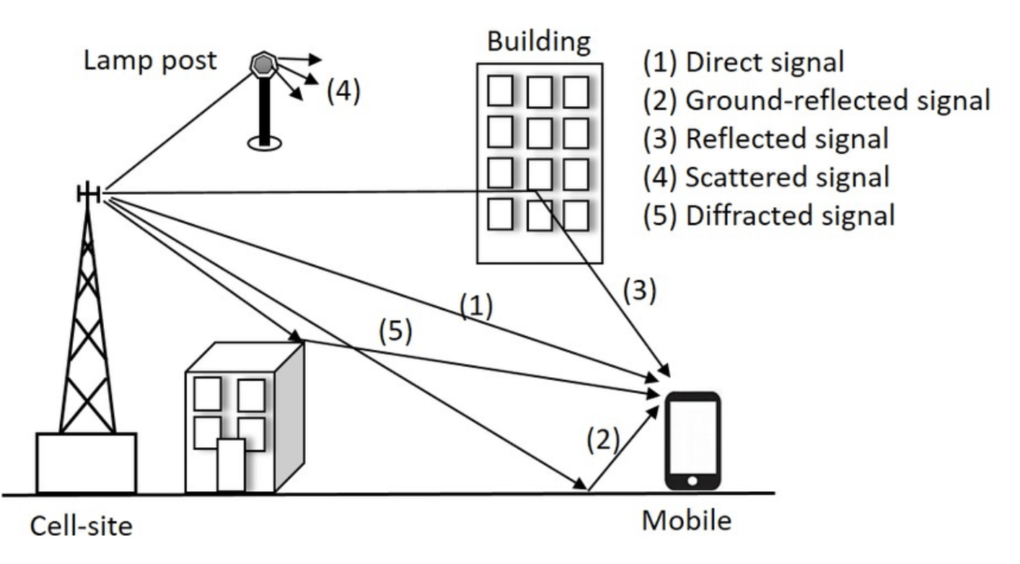
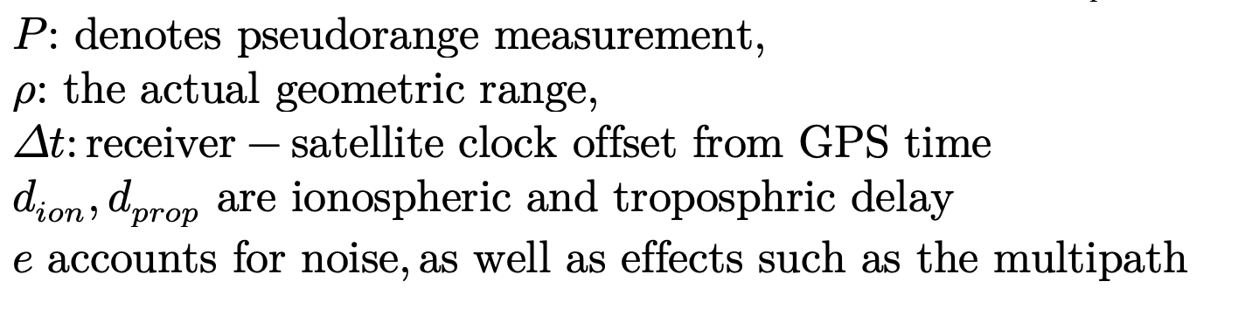
Pseudorange measurement
Navigation system outputs are estimates around certain range (pseudorange)
The accuracy for pseudorange measurement of the distance from the satellites to a receiver can be given by

Slide 26
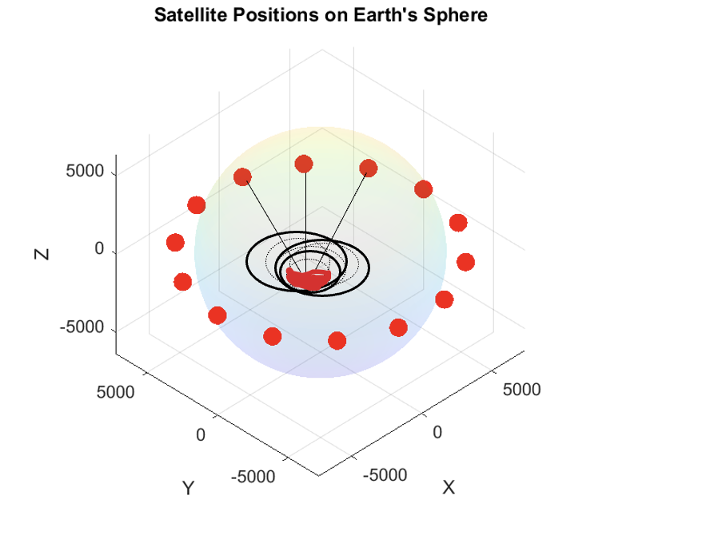
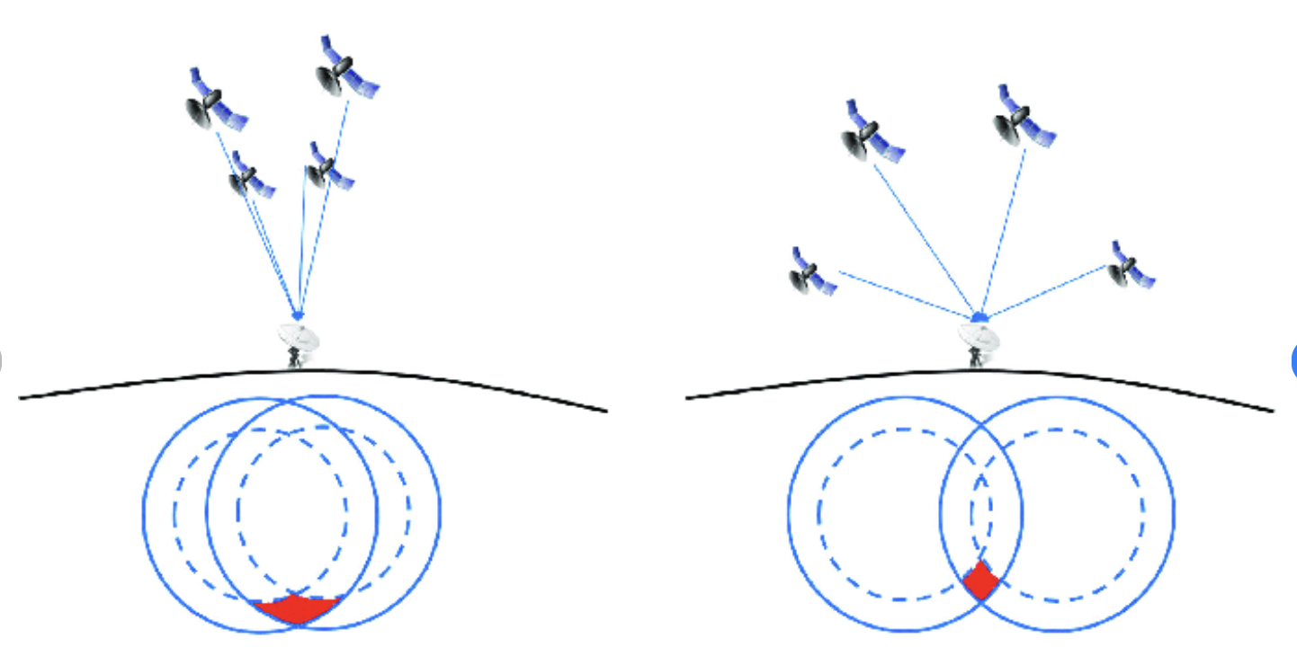
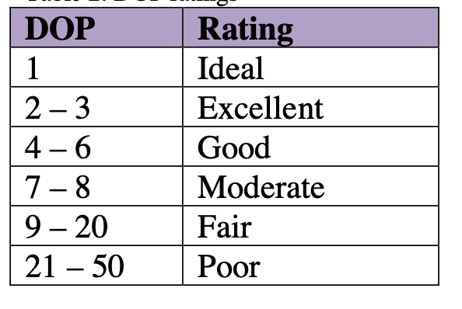

Pseudorange inferred from GDOP

Slide 27
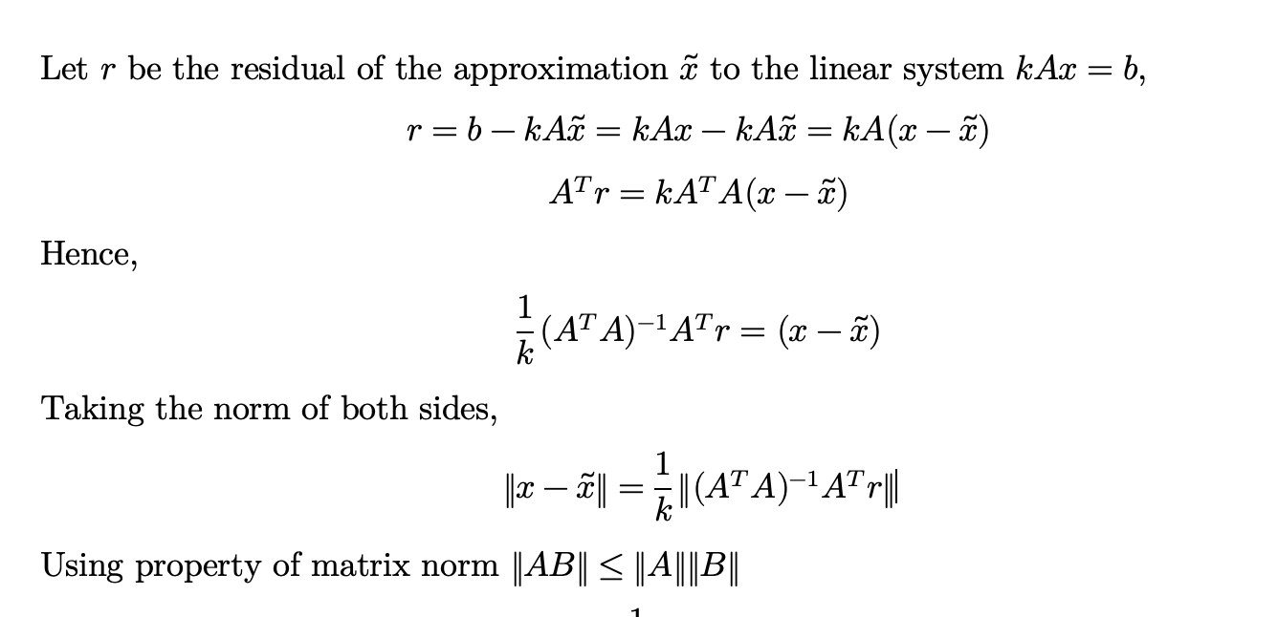
Condition Number - error bound on the approximation

Slide 28
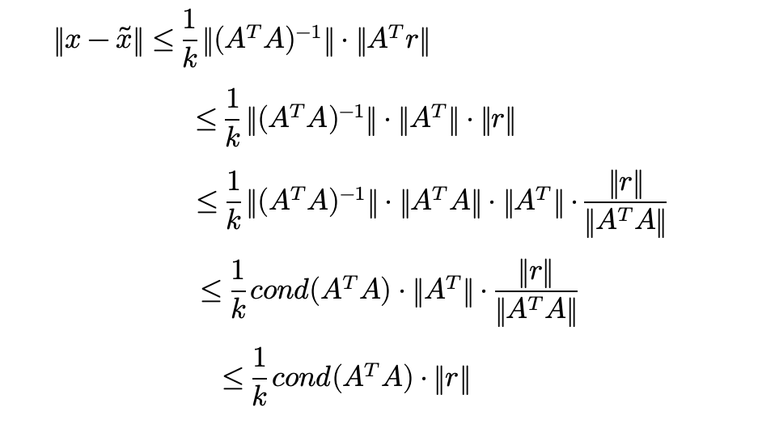
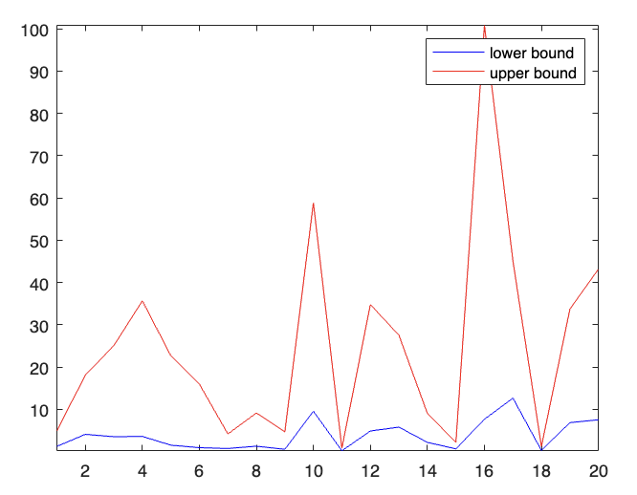
Well conditioned when cond is small (-> 1) [3]

Slide 29
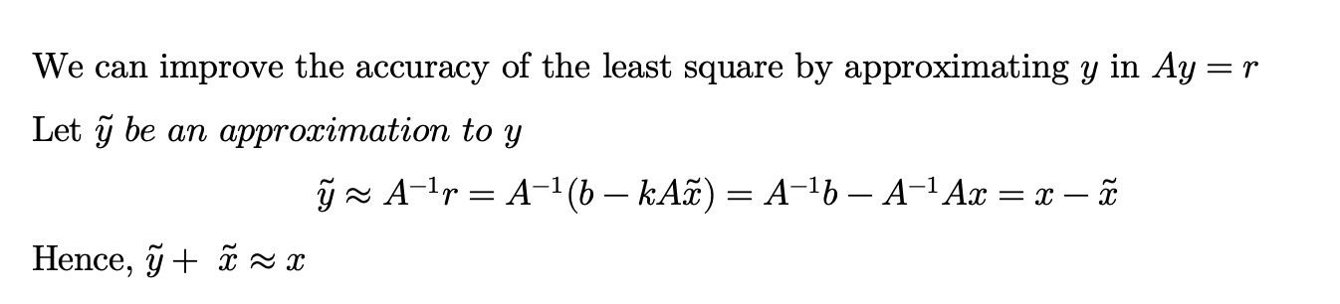
Iterative Refinement
In general, through the iterative improvement
If well-conditioned system, only need a few more iterations.
If ill-conditioned system, an increased in digit precision will be needed. [3]

Slide 30
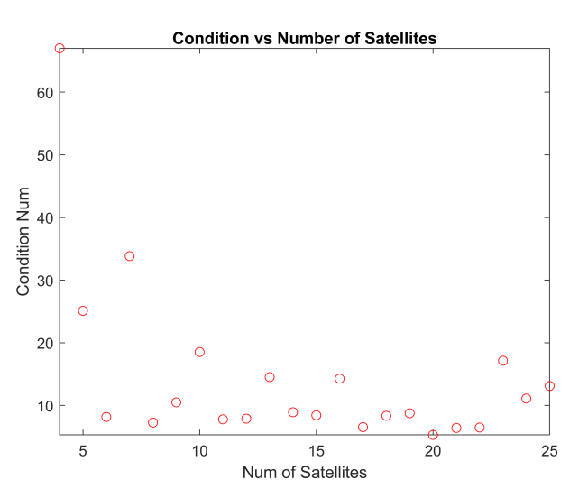

Slide 31
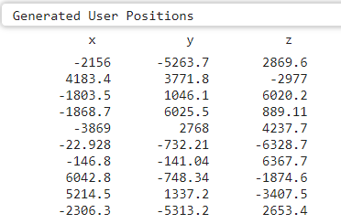

Slide 32
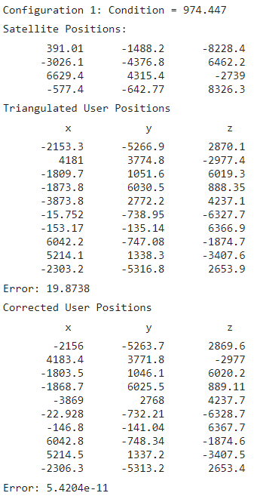
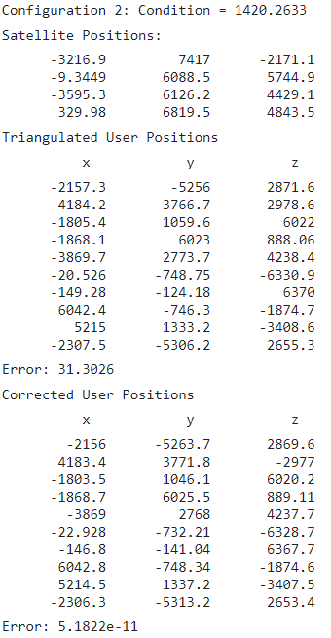

Slide 33
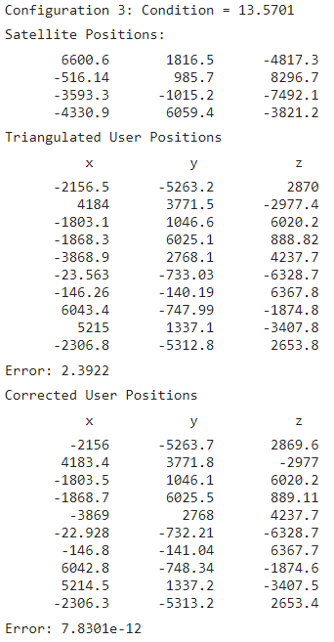
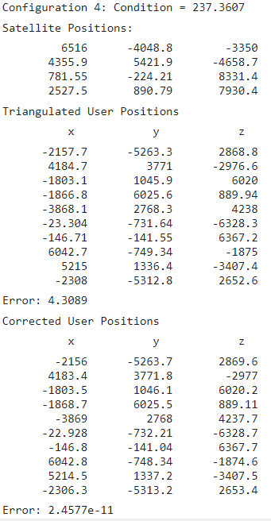

Slide 34
Works Cited
[1] A. Alshareef et al., “Application of trilateration and Kalman filtering algorithms to track dynamic brain deformation using sonomicrometry,” Biomedical Signal Processing and Control, vol. 56, p. 101691, 2020. doi:10.1016/j.bspc.2019.101691
[2] G. Strang, Introduction to Linear Algebra, 5th ed. Wellesley, MA: Wellesley-Cambridge Press, 2016.
[3] R. L. Burden, J. D. Faires, and A. M. Burden, “Error bound and Iterative Refinement,” in Numerical analysis, Cengage Learning, 2016, pp. 476–483
[4]I. Mironovova, I. Hynek, H. Supervisor, Vejražka, and D. Jiří Bíla, “Calculation of GDOP Coefficient.” Accessed: Dec. 04, 2023. [Online]. Available: https://stc.fs.cvut.cz/history/2011/sbornik/papers/pdf/1100016-1.pdf
‌

